Slide 1
Sneak Preview New Age Interactive Soccer Training System
Arnold Lee
CS 523 – Interactive Design
October 4th , 2011

Slide 2
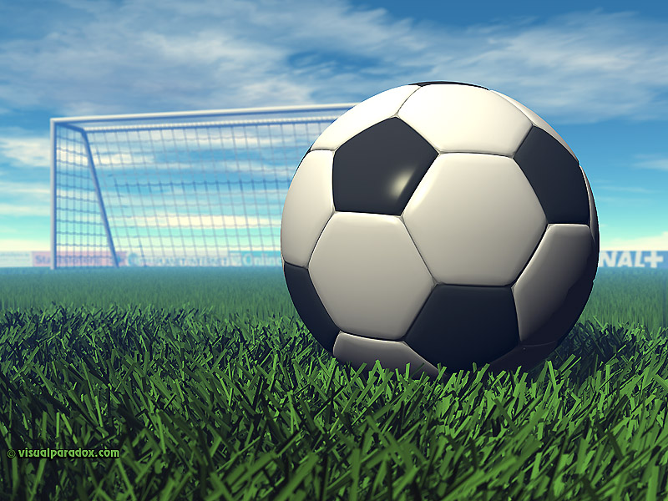
Problem statement
To design an interactive training environment for soccer players to learn proper tactics and team play in the field
Primarily design for secondary school level or below
Why soccer?

Slide 3
Motivation
Primary Objective:
Proper play tactics
Promote team spirit and improve communication skills on the field
Identify potential abuses:
Ball hogging (and certain other selfish behavior)
Foul play
Refusal to take part in a match
Intentionally aiding the opponent (rogue behavior / griefing )
Secondary objective:
Improve social interaction off the field
Reduce childhood obesity

Slide 4
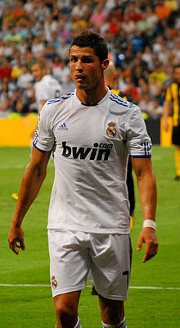
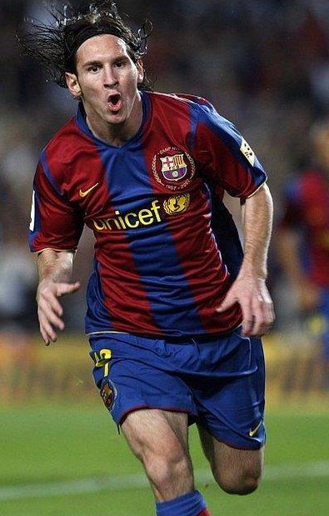
Cristiano Ronaldo
Lionel Messi

Slide 5

Cristiano Ronaldo
Lionel Messi

Slide 6
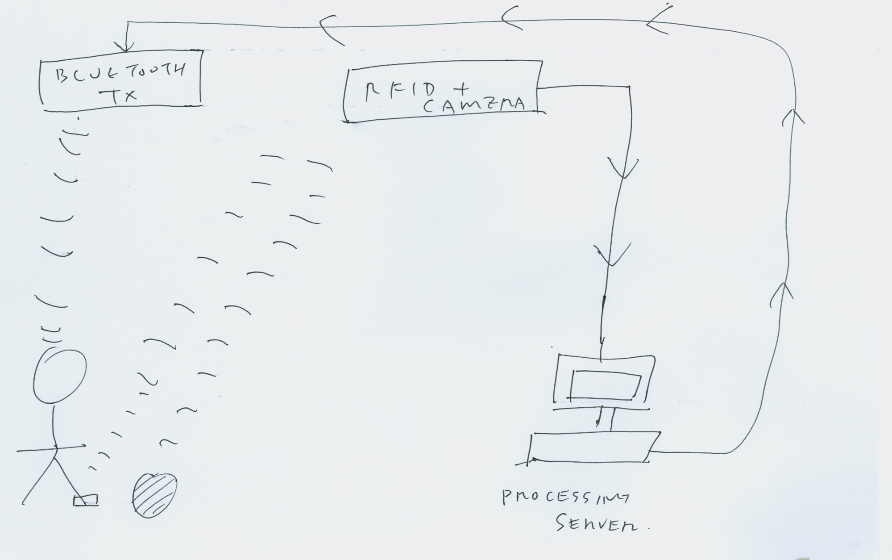
Proposed System

Slide 7
Current Technologies
Track movement using GPS
GPS does not provide accurate enough location for sensing interactions
Weak signal when used under garments
RFID or ultrasonic sensors
Short range
Suitable for indoor or localized outdoor uses
Light weight
Camera tracking
Short to medium range
Subject to obstruction

Slide 8
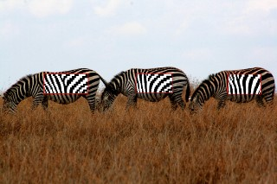
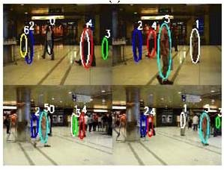
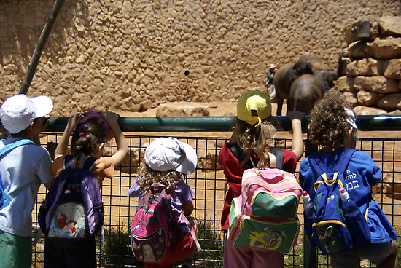
Notes:
Professor Schonfeld and his former doctoral student, Prof. Wei Qu from Chinese Academy of Sciences, have developed a new method for distributed multi-target tracking from multiple cameras demonstrated here in a crowded scene at Union Station in the City of Chicago.

Slide 9
Tangibles
Obviously, some of the stuff in the proposed system are not here YET
Limited budget, time and human capital
Project will be scale down to the implementation of the software part
GUI: create using Qt creator
Programming Language: C++
Core AI: A* search
Demo size: Initially set only on 5-a-side soccer
Leave some lose ends for future expansion/other inputs

Slide 10
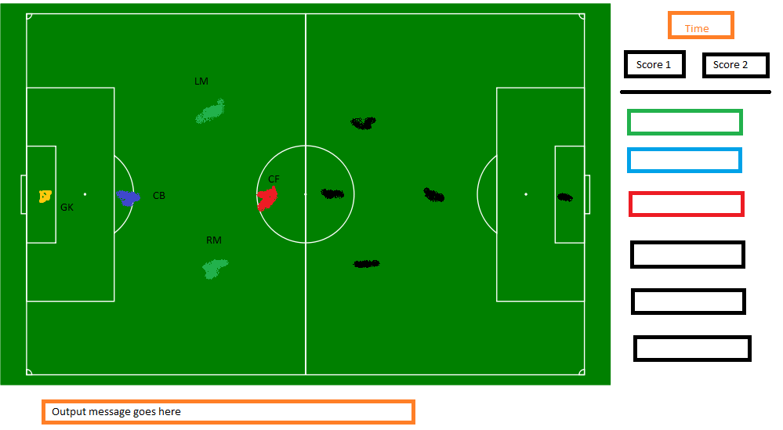

Slide 11
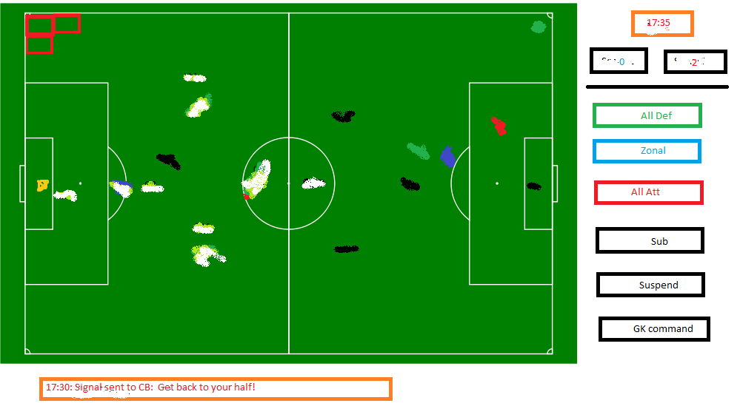

Slide 12
PEAS description (demo)
Performance measure: # of goals scored vs. # of goals allowed at the end
Environment: a field of 65 * 50 yards , each grid cell occupies 25 square yards
Actuators: (jog/sprint) ^ ( direction ) ^ ( ( pass / shoot ) XOR (dribble) XOR (tackle/slide) XOR (handle) )
Sensors:
Position ( RFID / Camera ), both teams
Possession
Current score
Time left

Slide 13
Tangibles
Input
Basi of Info and initial position of each player (ST/xF/xM/xB/xWM/xWB/CDM/SW/GK)
Radio input of each player position in real-time
Demo only: a template of simulated radio input
Output
An radio message sent every 30 seconds to the player via Bluetooth headset
A “compliance index”
Demo only: an on-screen message that indicates what is being sent to each player
Demo only: simulated results

Slide 14


